Slide 1
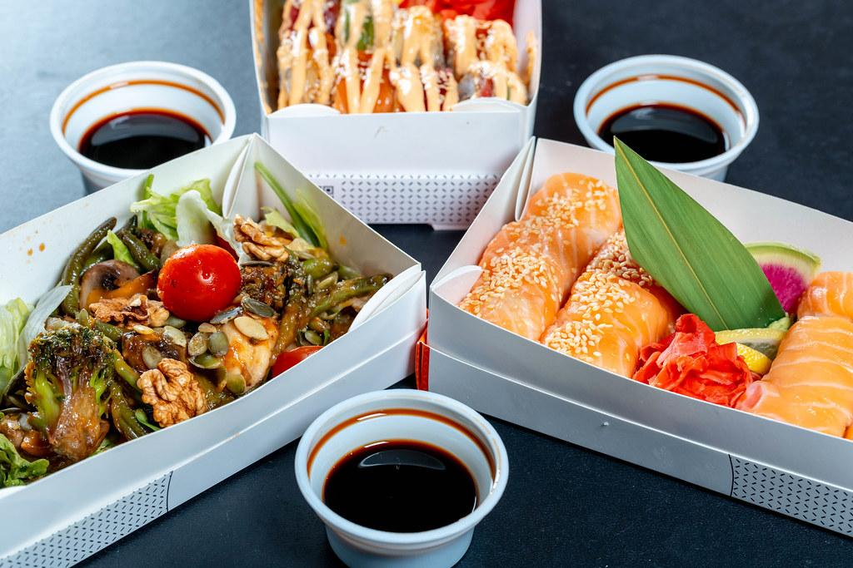
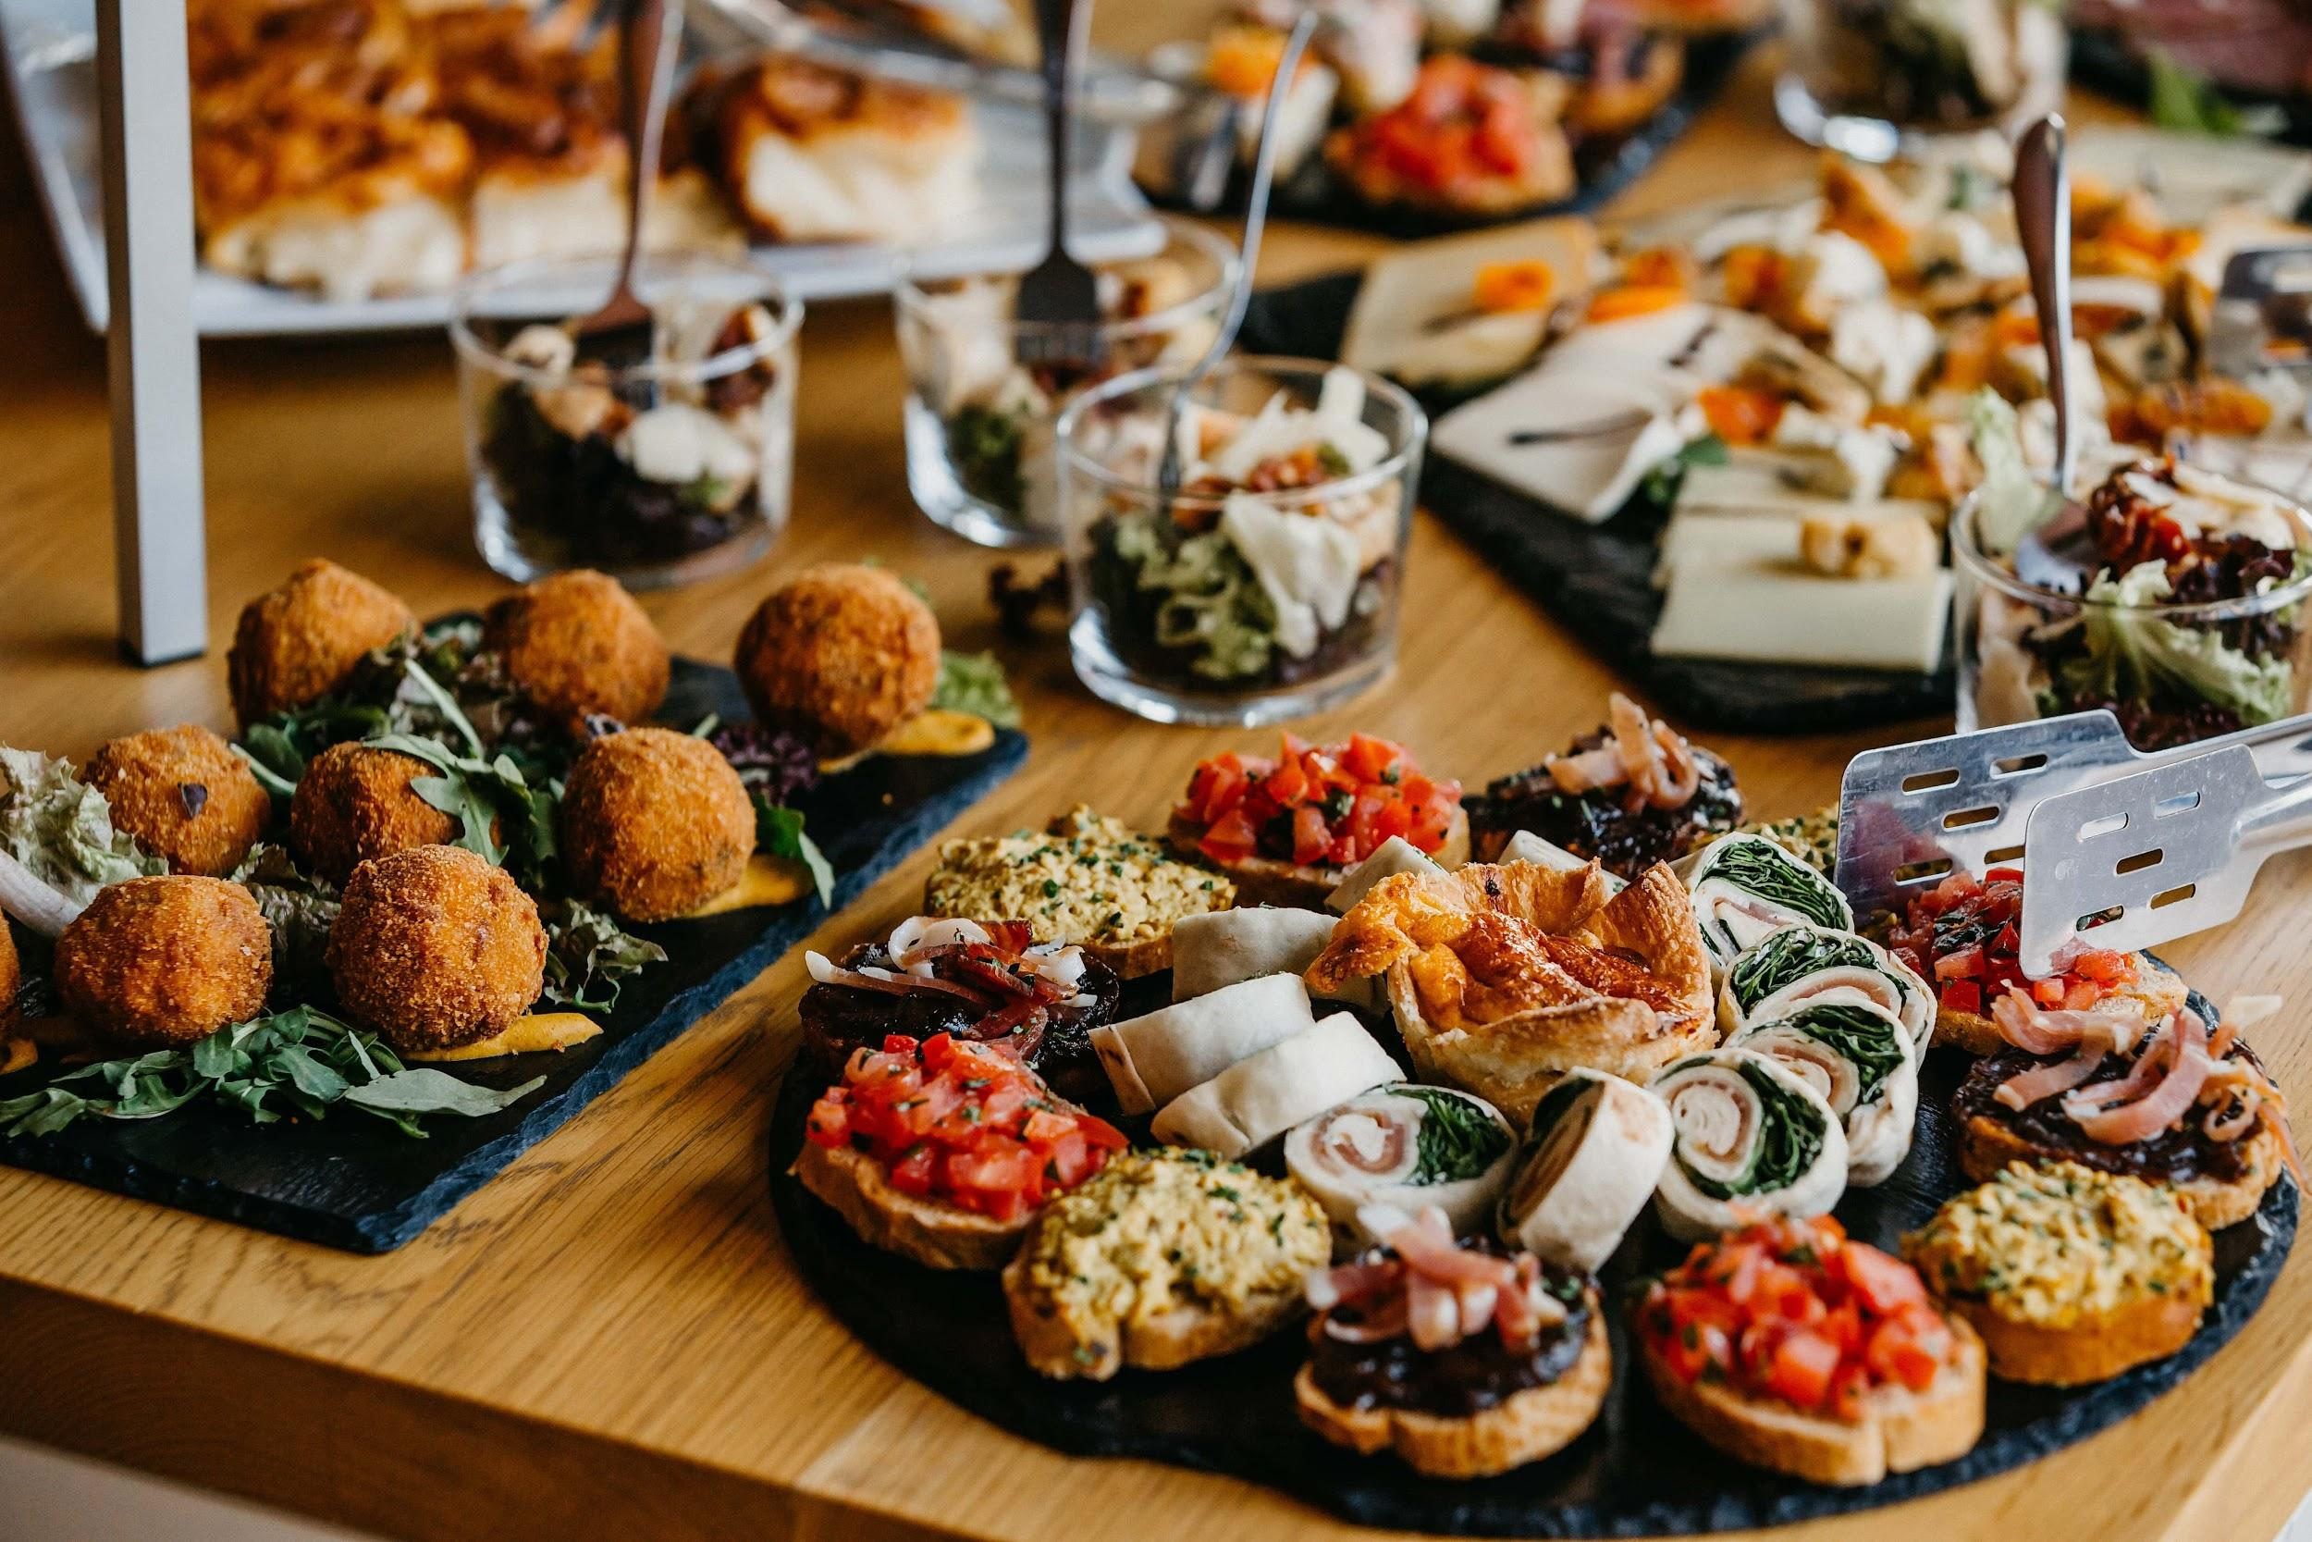
CampusEats Database Group 21:
Ara Chung, Yogesh, Pooja, and Dalton

Slide 2

Index
-----------------------------------------------------------------------------
Model and Tables
Corrections to Existing Database
Views and Output

Slide 3
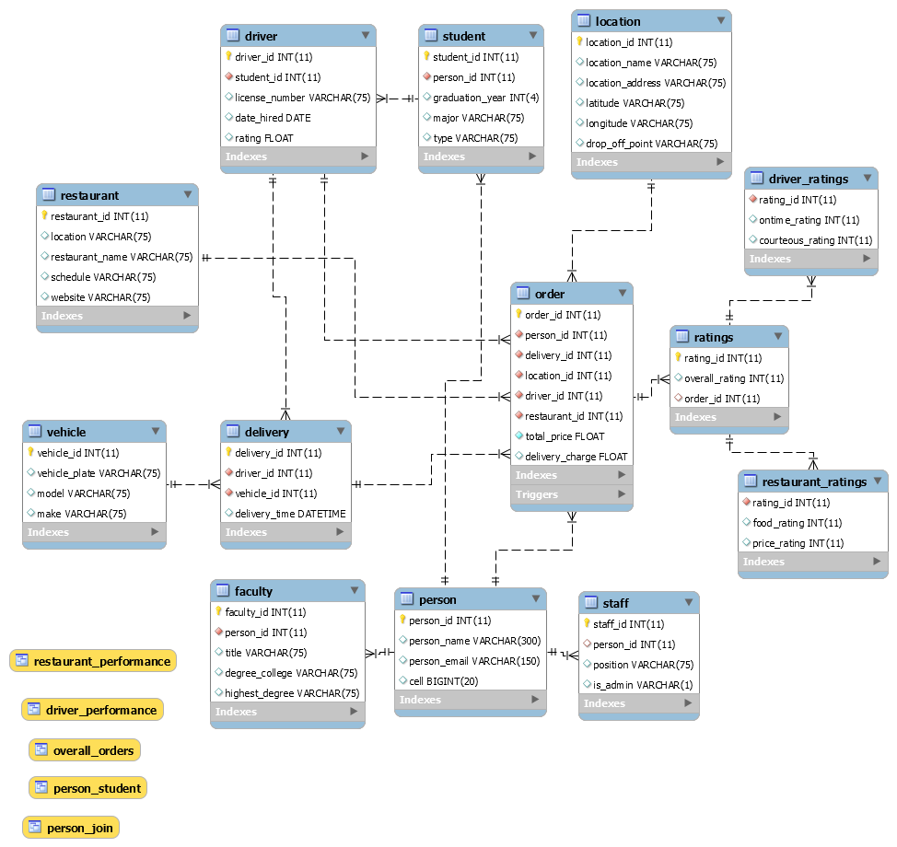
Model with Rating Tables

Slide 4
Model with Rating Tables
Ratings
Rating_id (PK)
Overall_ratings
Order_id
Driver_ratings
Rating_id (FK)
Ontime_ratings
Courteous_ratings
Restaurant_ratings
Rating_id (FK)
Food_rating
Price_rating

Slide 5
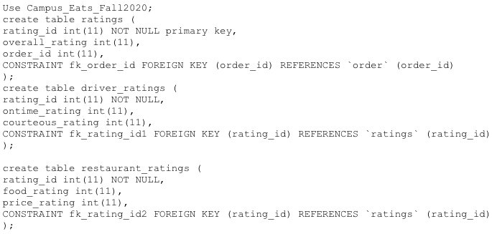
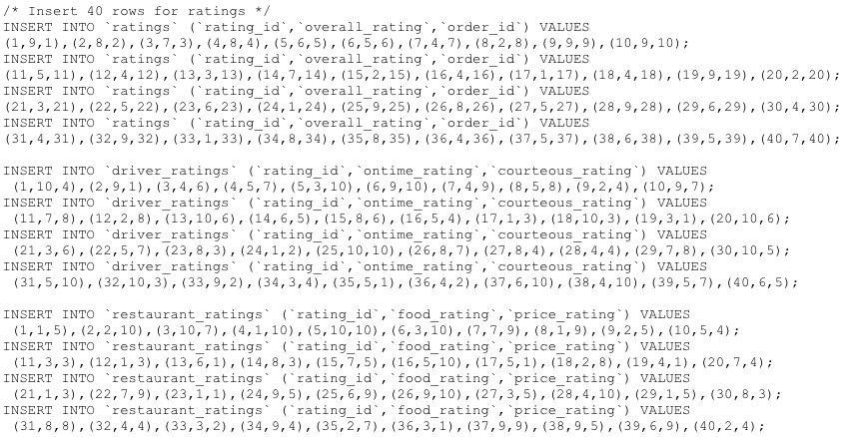
Table

Slide 6
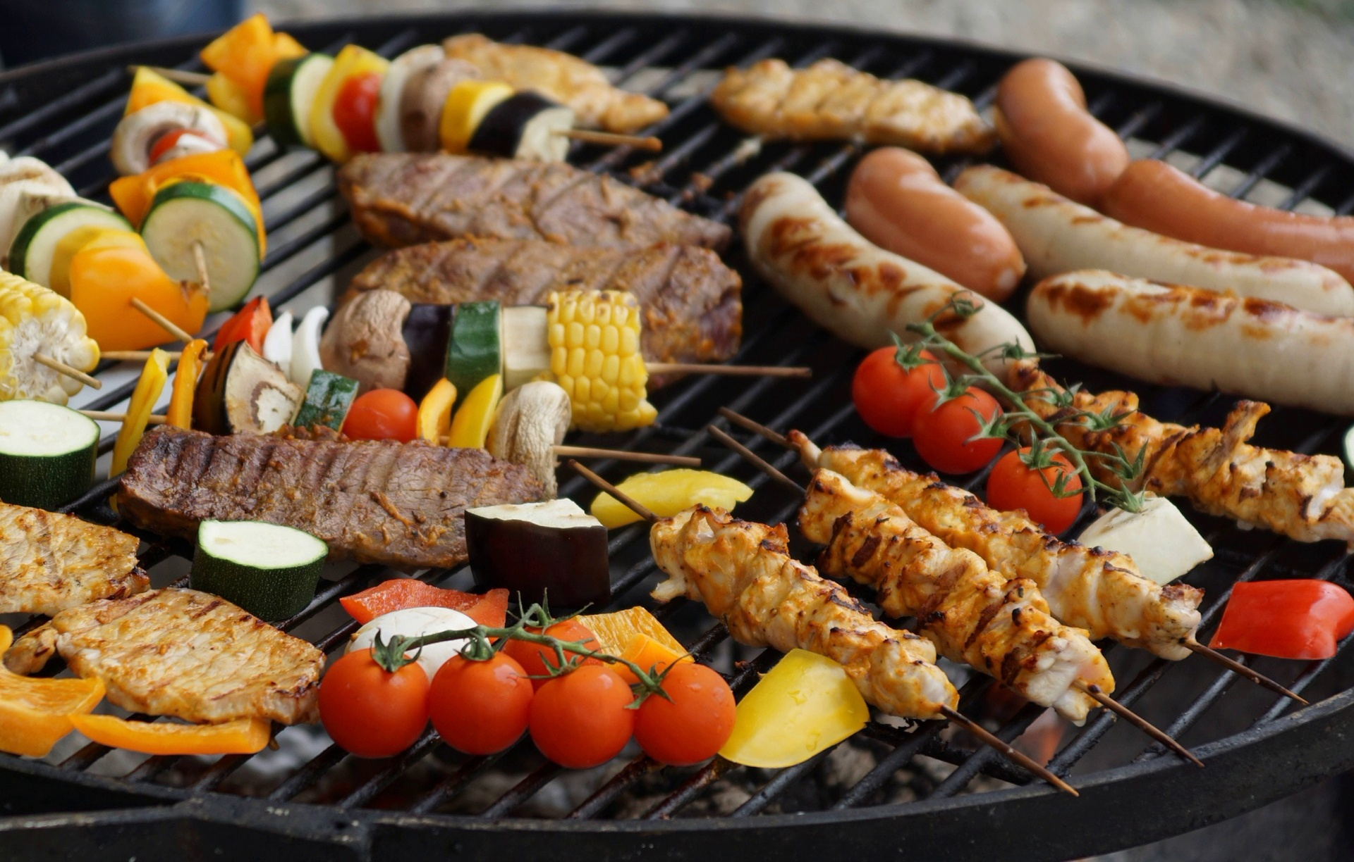
Changes to the Database
Created the ratings, driver_ratings, and resturaunt_ratings tables
Generated the driver_preformance, restaurant_performance, and overal_performance views
Re-arranged the joins and arrangement of tables
Have the vehicle join only with the delivery table
Delivery Table has references for all vehicle and driver information
Connect the Driver table directly to the student table
Location table joined onto Order table

Slide 7
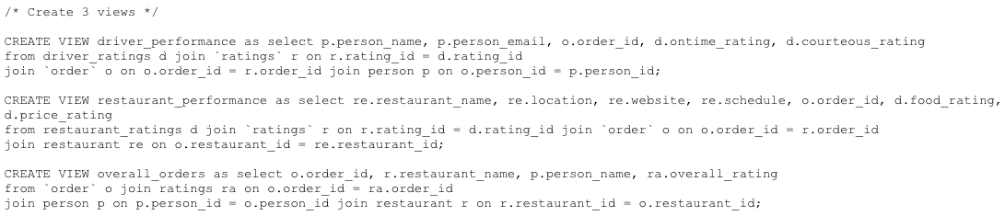
Views and Output
Created three views
Driver_performance
Resturaunt_performance
Overall_orders

Slide 8

Views and Output
Created three views
Driver_performance
Shows performance metrics like ontime rating and courteous rating
Has information about every order and driver
Resturaunt_performance
Shows performance metrics like food rating and price rating
Gives location, contact, and schedule information for each restaurant
Overall_orders
Provides the overall order rating
Shows the order_id, person who ordered and where it was from
Index
Primary key and Foreign Key

